Slide 1
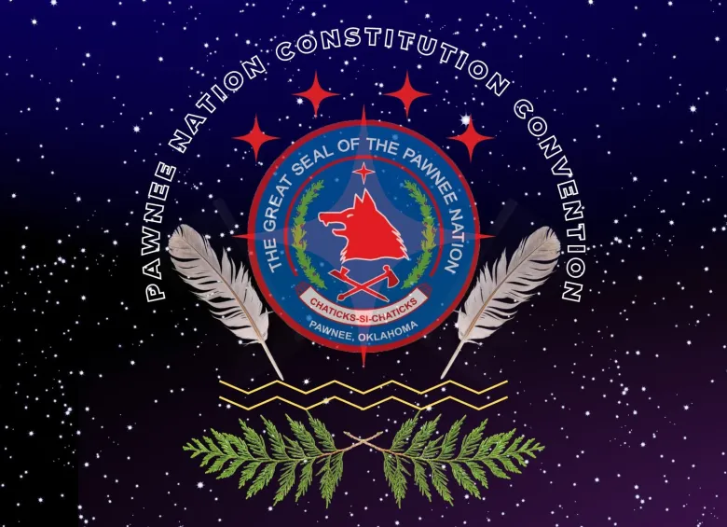
Pawnee Nation Constitution Amendment 2022-2026
A Path to creating a more effective and
legitimate constitution

Slide 2
WHAT IS A CONSTITUTION?
A living, breathing document that outlines the fundamental principles, laws, and regulations of a nation or government
Serves as the Supreme Law of the land
Sets limits on the power of the government
Establishes the rights and freedoms of citizens
Designed to provide stability, protect human rights, and ensure democratic processes
Can be amended or revised over time, but the process is often deliberate and requires widespread support
An essential component of a Nation's political system and shapes its governance and policies

Slide 3
CONSTITUTION ORGANIZATION
Constitutions outline the framework and powers of a government in several Articles or Sections. There are separate Articles for each branch of government that spell out their structure and provide rules and responsibilities for officials in each branch.

Slide 4
Most Constitutions Address:
Who are we as a people?
Where are we from?
What do we value?
How do we make decisions?
Who has authority over what?
What kinds of relationships do we expect to have with each other, with outsiders, and with the world around us?
How do we choose our leaders?
How do we deal with disagreements or disputes among us?
How do we organize to get things done?

Slide 5

WHERE DO OUR CONSTITUTIONS COME FROM?
The United States encouraged (forced) many Native Nations to adopt written Constitutions in the 1930s after passage of the Indian Reorganization Act and the Oklahoma Indian Welfare Act. Most of these Constitutions follow simple models (aka boilerplates) provided to American Indian Nations by the U.S. government.

Slide 6
Questions to Consider
Does it express our own core values?
Does it effectively communicate who we are as a people and what matters to us?
Do our people view the current Constitution as our Constitution or as someone else’s idea of how we should govern?
How well does our current governing system work?
Would we describe it as effective or ineffective?
Does our current Constitution give our Nation the tools it needs to achieve its goals?
Is the Constitution clear, and is it enforced? Do our citizens understand it?
Do our leaders live by it?

Slide 7
KEY CONCEPTS
To better reflect individual political cultures and traditions
Assert inherent governing powers
Enhance the accountability of elected officials
Strengthen government stability
Provide a sound foundation for the increased exercise of sovereignty

Slide 8
PURPOSE OF CONSTITUTION CONVENTION
Is a fundamental exercise of self-determination, self-governance, and sovereignty
To update, upgrade, and strengthen the Constitution
Will lead to a better form of government
Create a stronger Nation for future generations

Slide 9
…The Pawnee Nation Constitution was adopted pursuant to the Oklahoma Indian Welfare Act of June 26, 1936 (49 Stat. 1967) which superseded the constitution approved by the Secretary of the Interior on November 26, 1937, and ratified on January 6, 1938, as amended. The Constitution has been revised and amended by Referendum vote on July 14, 1998, January 4, 2003, June 14, 2008, and further revised by referendum vote on May 1, 2021.

Slide 10
HOW IS THE PAWNEE NATION CURRENTLY GOVERNED?
The Pawnee Nation Constitution currently contains a Preamble and fifteen (15) Articles, and sets forth two branches of government:
The Pawnee Business Council and Pawnee Nation Courts

Slide 11
PREAMBLE
The statement is written so that the objective of and basis for the Nation are easily understood. The Preamble cites the specific authority under which the Constitution will be adopted or ratified. If the Nation was organized under an earlier governing document, the earlier document may be acknowledged along with an explanation that it is now superseded by the current proposed Constitution.

Slide 12

PURPOSE: TERRITORY AND JURISDICTION
TERRITORY AND JURISDICTION Statements accurately describe the NATION’s geographical territory and the extension of jurisdiction. Reference may be made to all treaties, Executive Orders, and/or specific congressional acts relating to establishment of the reservation or area within which the NATION has jurisdiction. This article MAY include a statement that jurisdiction over the NATION’s territory is subject to Federal law.

Slide 13

ENROLLMENT
The Article clearly describes the requirements for enrollment and may address the following:
Base Roll identification
Vested rights of previously recognized members
Authority to resolve enrollment questions
Application requirements.
Enrollment procedures
Adoption into membership, disenrollment, and dual enrollment may also be considered and set forth

Slide 14
GOVERNING BODY
The Article clearly and thoroughly describes the nature of the Nation’s governing body. It also addresses who is empowered to exercise the Nation’s legislative and executive powers. The Article provides for:
The title and number of positions that constitute the governing body
The means through which office holders are elected (i.e., from within or by running for a particular office)
Staggered terms of office
Incumbents to continue in office until their successors are duly elected and installed
Filling vacancies
AUTHORITY

Slide 15

DUTIES OF OFFICERS
The Article clearly defines the major duties of various officials.
Provisions are included for transfer of offices for newly elected officials upon expiration of the incumbent’s terms.

Slide 16
VACANCIES
The Article specifies procedures for filling positions in the event of death, resignation, removal, forfeiture, and recall.
The Article is clear and thorough enough to promote order in filling vacancies and to prevent undue confusion concerning the loss of government officials.

Slide 17
POPULAR PARTICIPATION The Article provides for election other that the regular elections of officials. Provisions established a viable “checks and balance” system.
FORFEITURE
SUSPENSION
RECALL AND REMOVAL
A legal process that can lead to the loss of office due to misconduct or other legal grounds.
A temporary removal of an official from office, often due to misconduct or other reasons, but not necessarily a legal process.
Recall: A process for voters to remove elected officials from office.
Removal: A legal process that can occur through impeachment, removal, or expulsion.

Slide 18
CONSTITUTIONAL POWERS
The article clearly SETS FORTH those authorities delegated to a governing entity or entities. If more than one governing entity is established, the article specifies which powers are vested in each entity. The article MAY include a reserve powers clause.

Slide 19

COURTS/JUDICIARY
The article clearly provides for exercise of judicial authoritY. The article requires creation of a judiciary that is independent from the functions of tHE government. The article enumerates accurately the scope of judicial powers. The article provides for election or appointment of judges by a process that frees the judiciary from potential pressures and influences of the government.
This Photo by Unknown Author is licensed under CC BY-SA

Slide 20
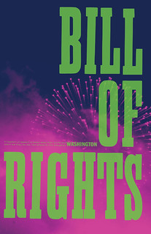
BILL OF RIGHTS
A Bill of Rights is created to ensure that certain rights and freedoms are protected and guaranteed free from infringement by the government.
A Bill of Rights gives power to people themselves and ensures that their most important individual rights and freedoms are not overlooked or violated.
This Photo by Unknown Author is licensed under CC BY-NC-ND

Slide 21
AMENDMENTS
The article clearly sets forth procedures for modifying or amending the constitution

Slide 22
MEETINGS
The article clearly provides for calling and conducting regular and special meetings including specific instructions regarding: What constitutes a quorum. When and where regular meetings are to be held, Who is responsible for calling the sessions, How many special or emergency meetings can be called.

Slide 23
SAVINGS CLAUSE
The article provides that all legislation enacted under any previous constitutions will remain in force to the extent that those enactments are consistent with the new constitution

Slide 24
Severability
The article provides that if any part of the constitution is held to be invalid or contrary to Federal or the nation’s law, the remainder of the document will continue in effect

Slide 25
SOVEREIGN IMMUNITY
The principle of sovereign immunity is a crucial aspect of the relationship between Tribes and the government. It is the legal protection that allows Tribes to avoid lawsuits in federal, state, and Tribal courts.
This immunity is not only a right for the Tribes but also extends to entities established by the Tribes, such as governmental agencies.
It also applies to individuals associated with the Tribes, including officers and employees, at least in some circumstances.
This immunity is a tool that Tribes use to protect and preserve a Tribe’s way of life and maintain their sovereignty.

Slide 26

Chaticks-si-Chaticks

